Slide 1
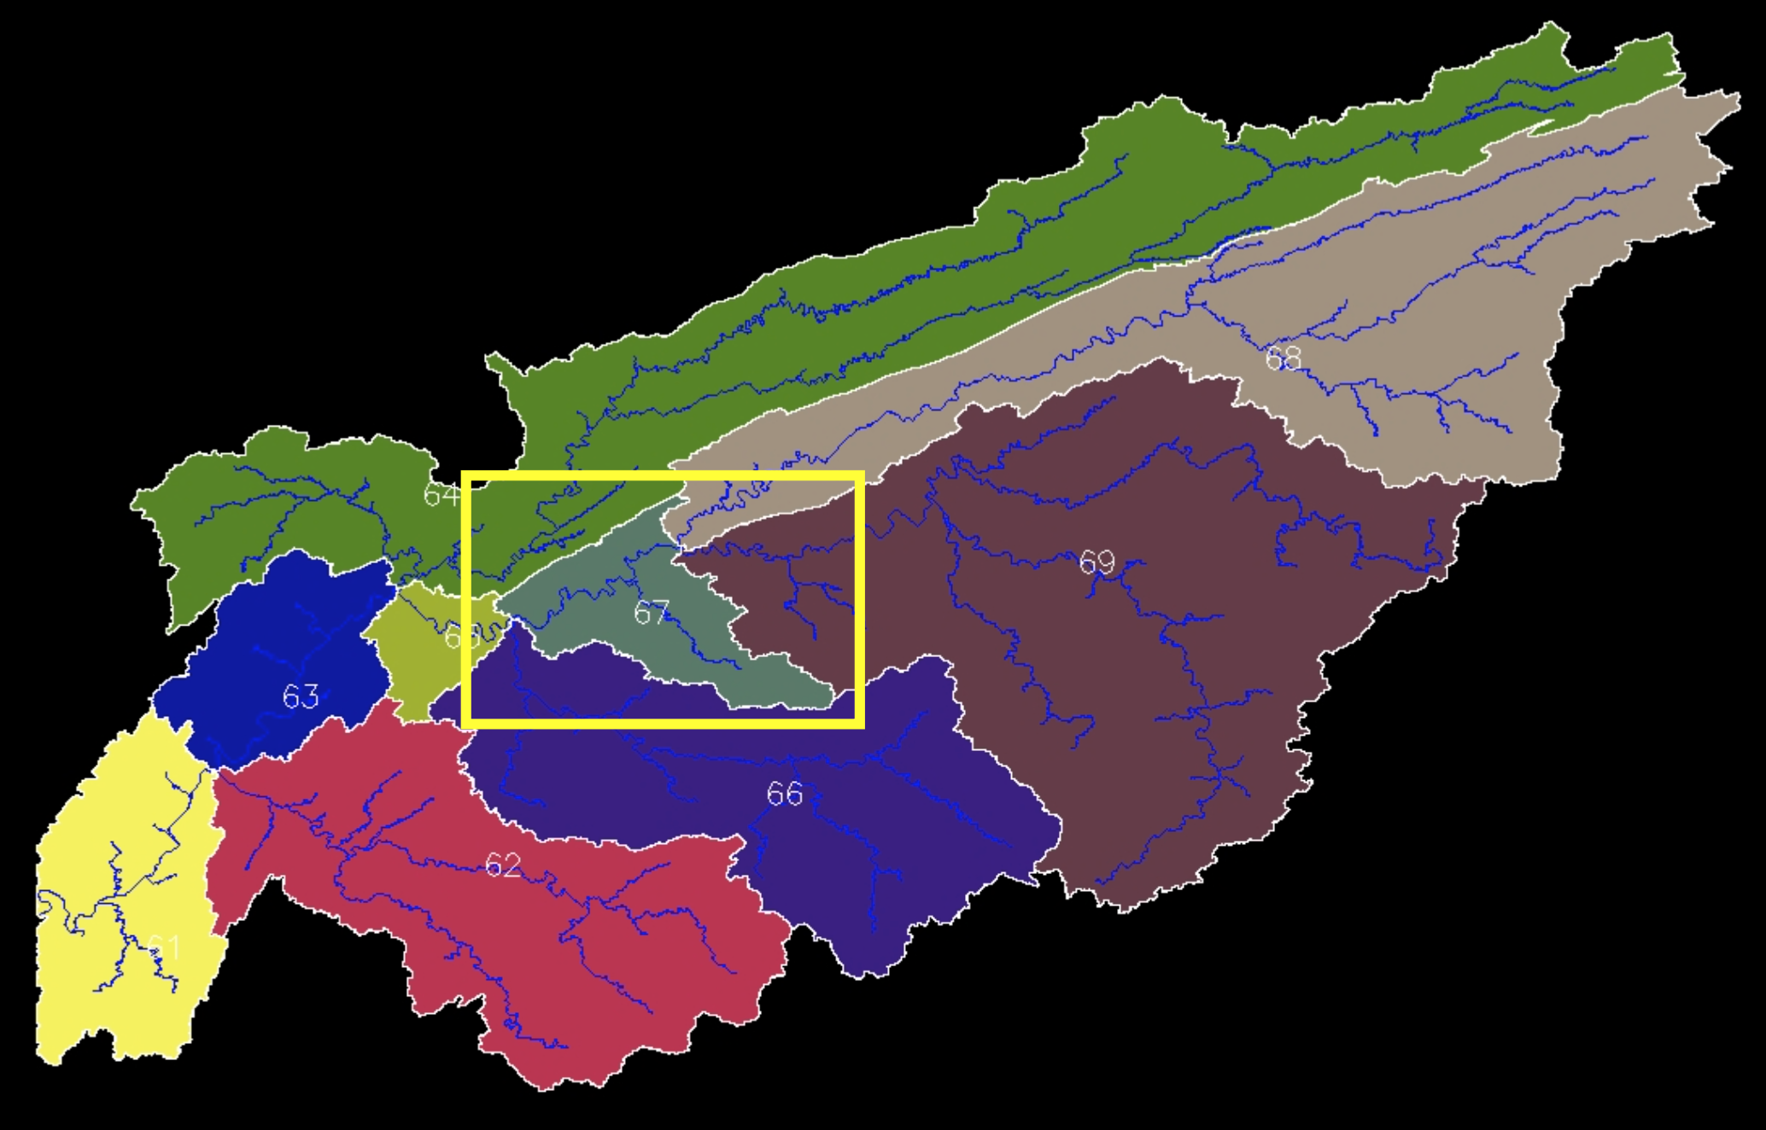
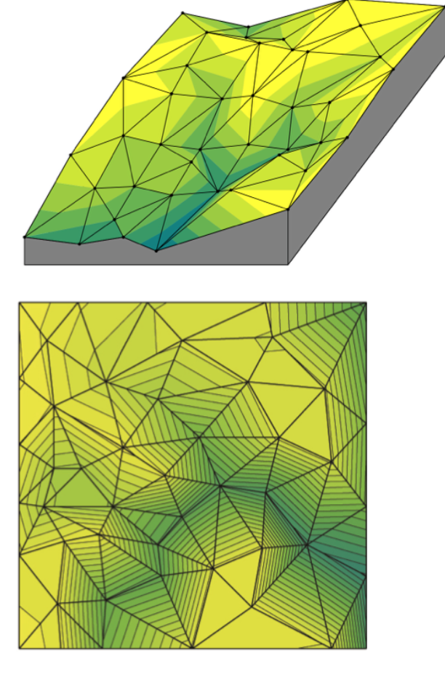
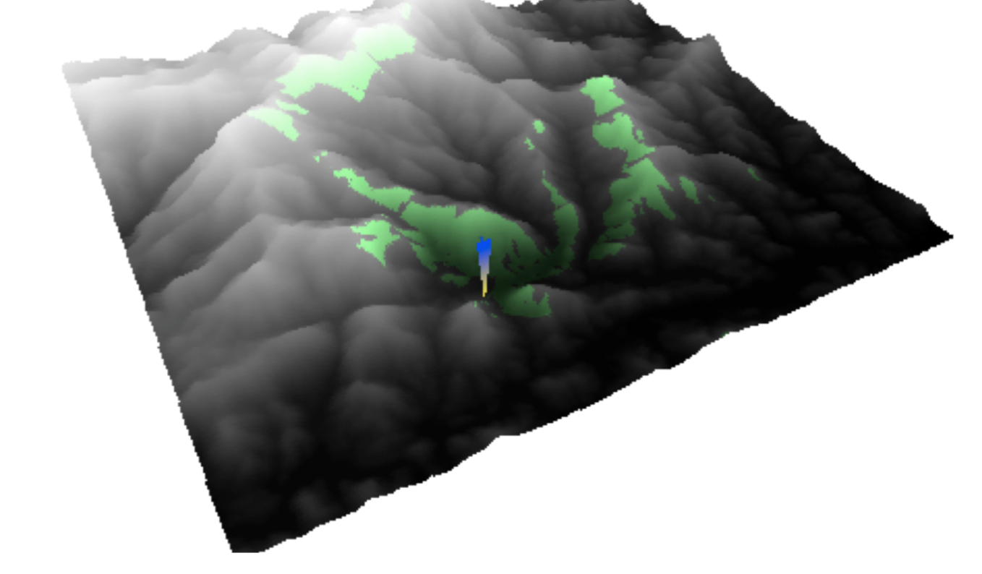
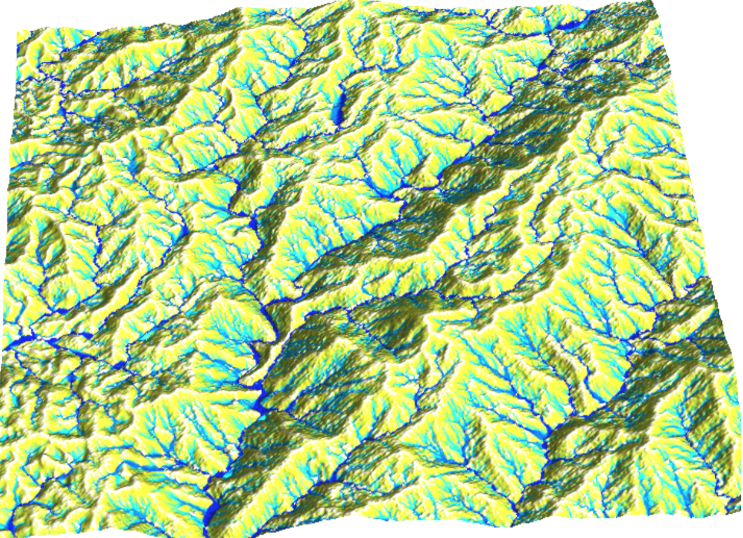
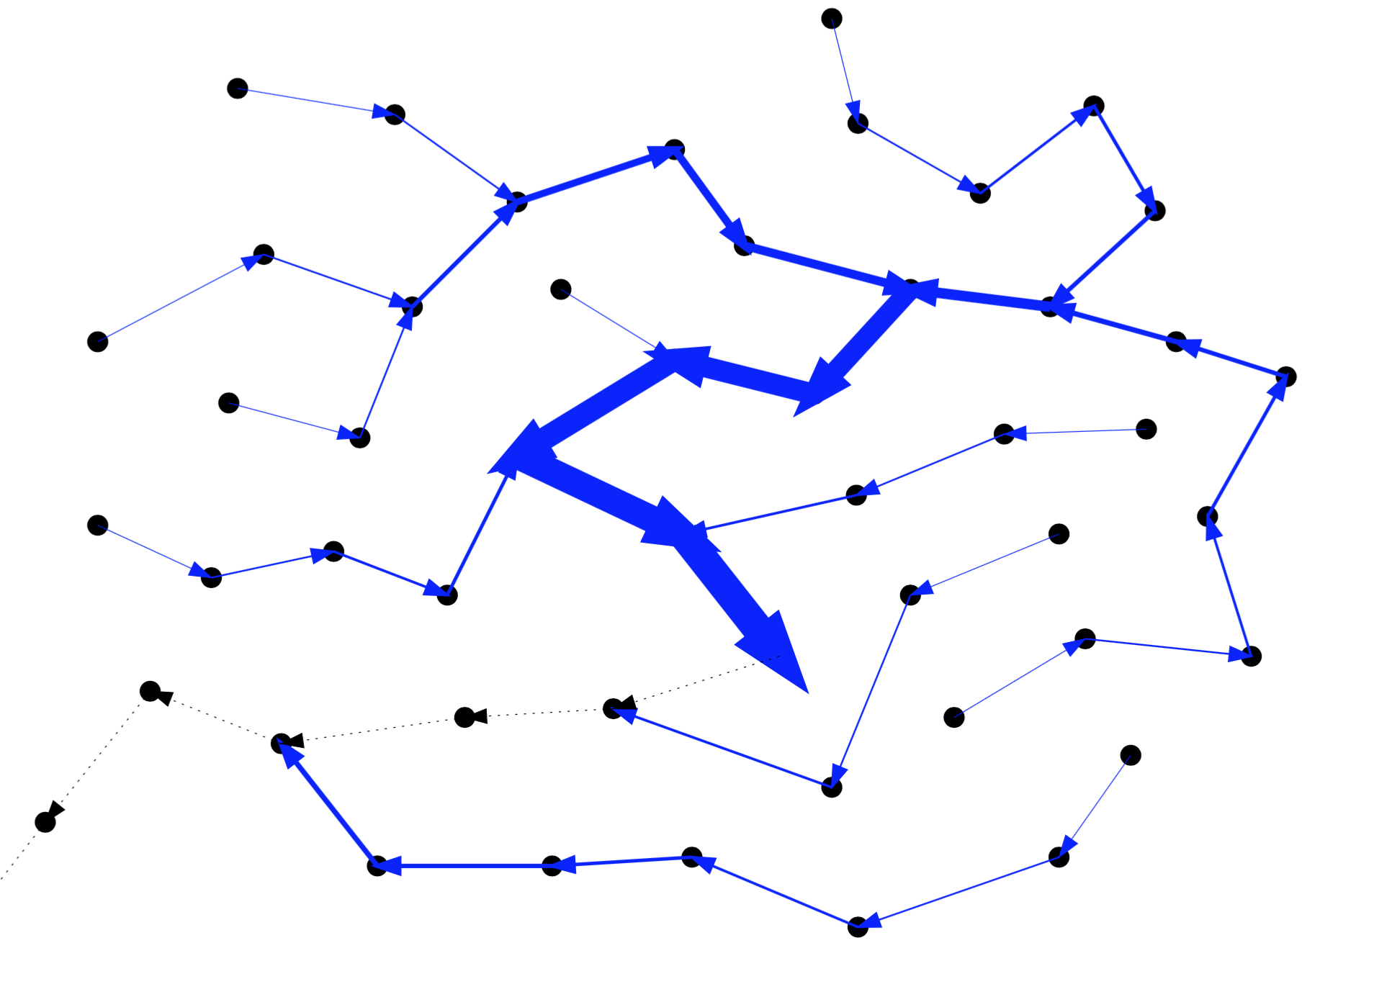
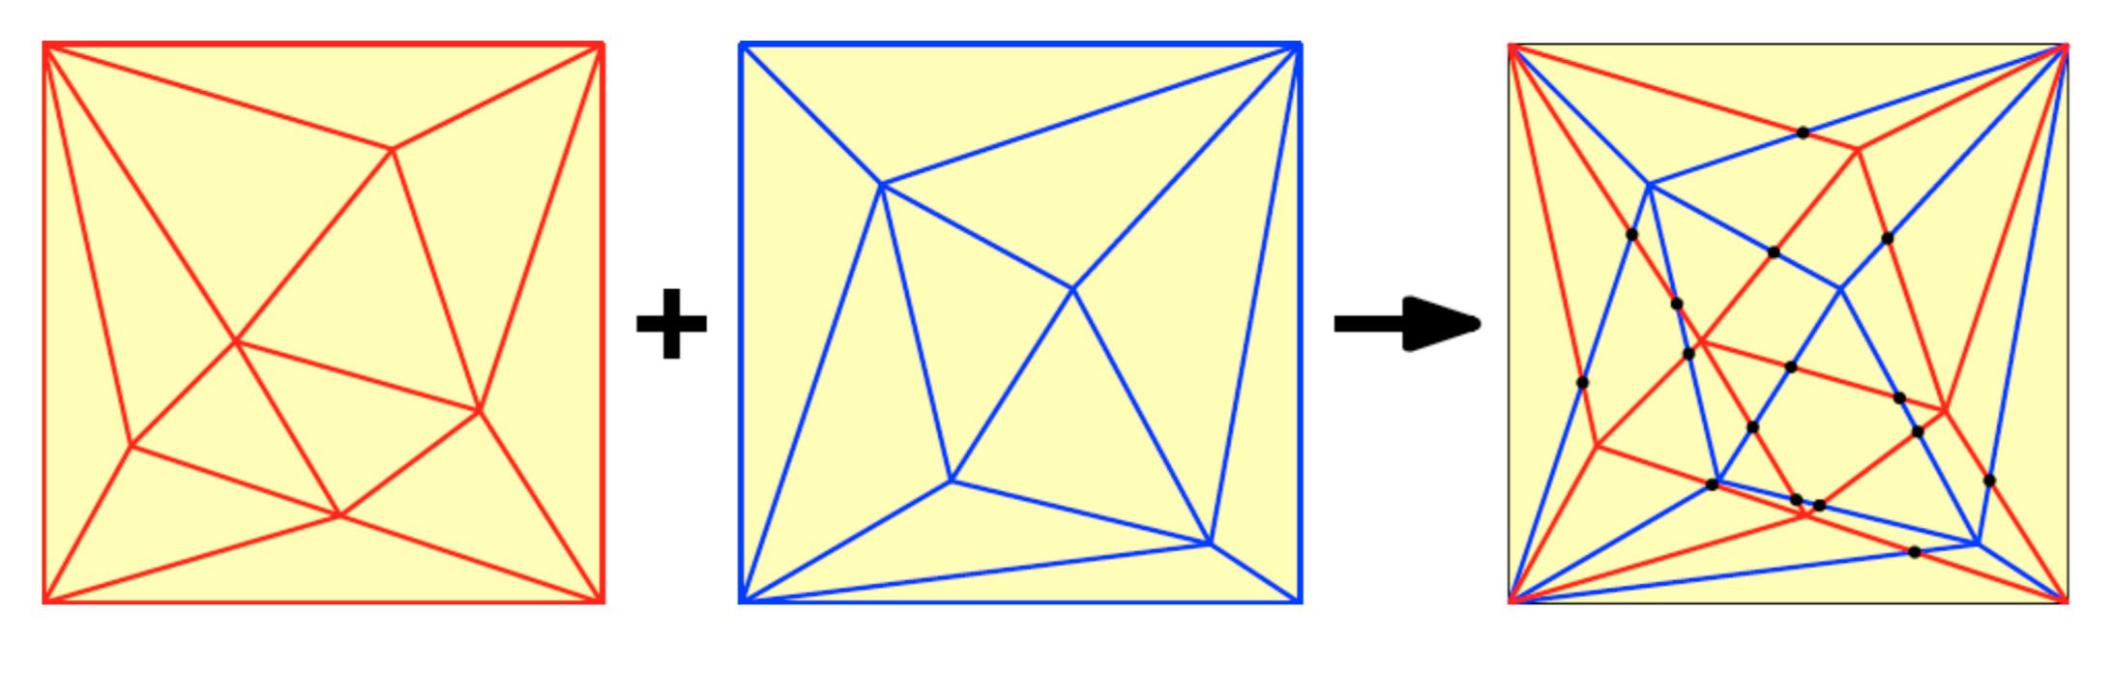
Laura Toma:
Applied Algorithms

Slide 2
Terrain modeling in GIS
Algorithms for large data
Algorithm engineering
High performance computing

Slide 3
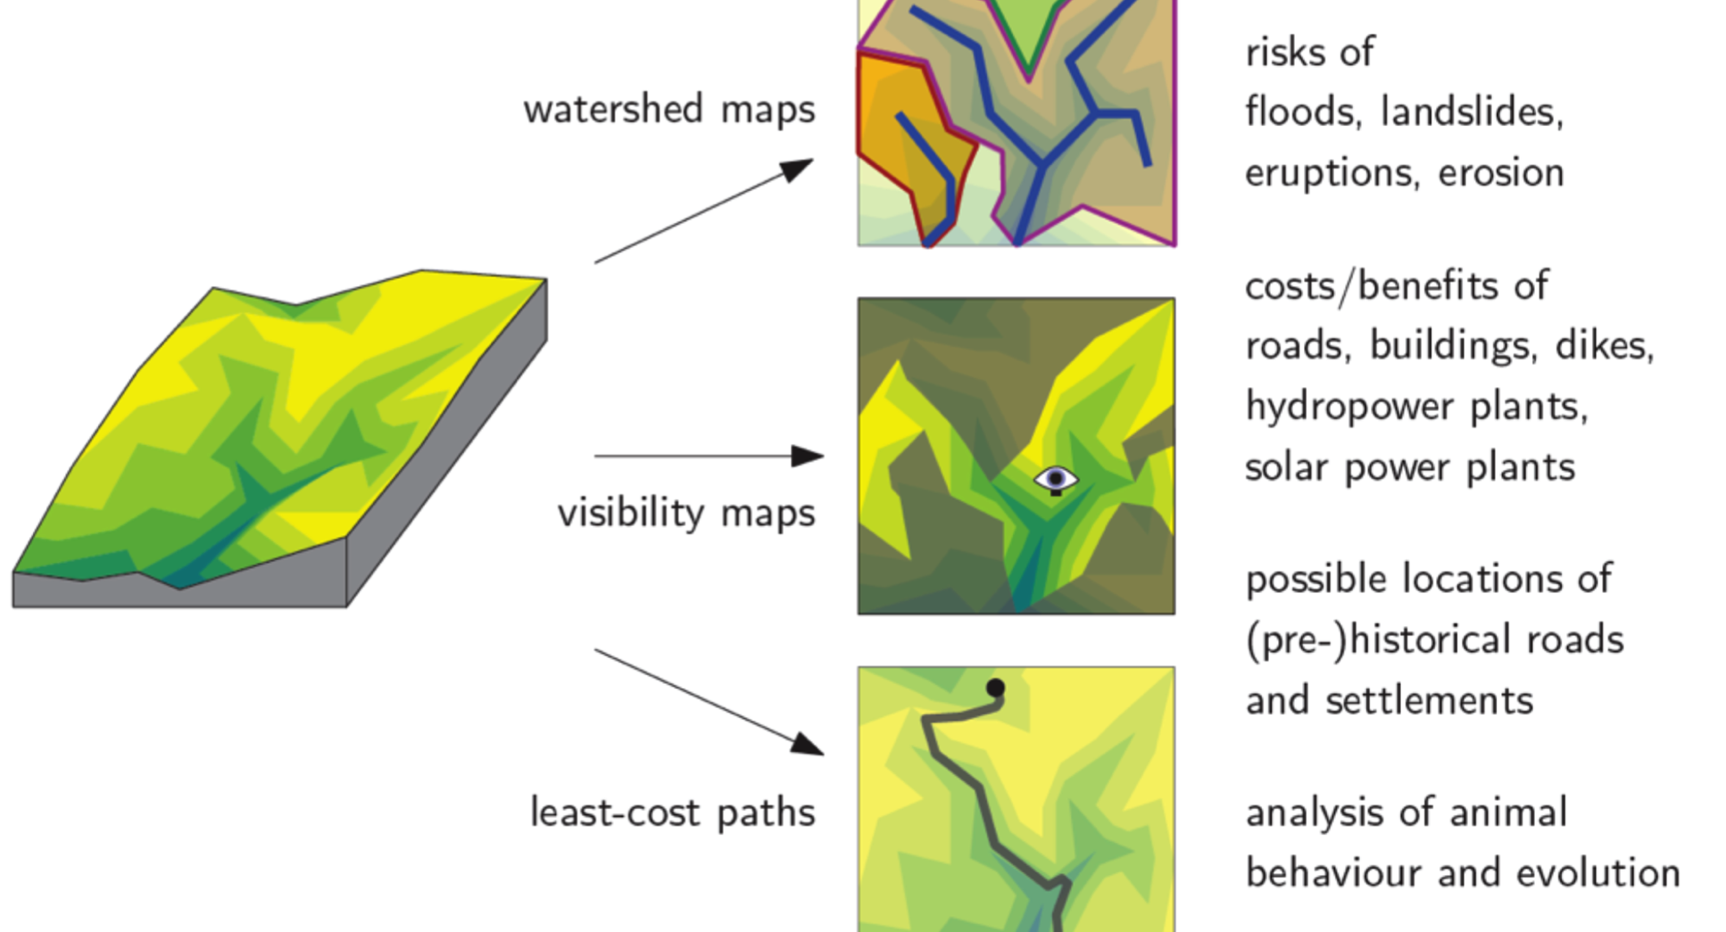
Terrain Modeling in GIS

Slide 4

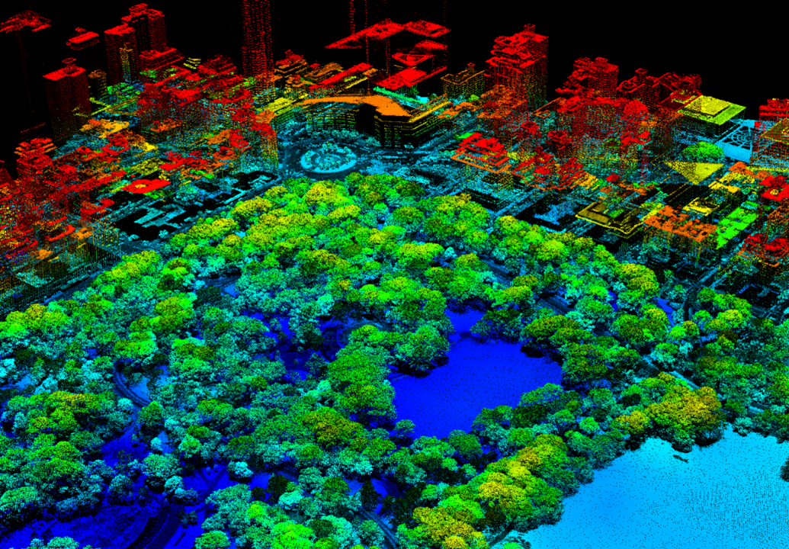
Large data

Slide 5
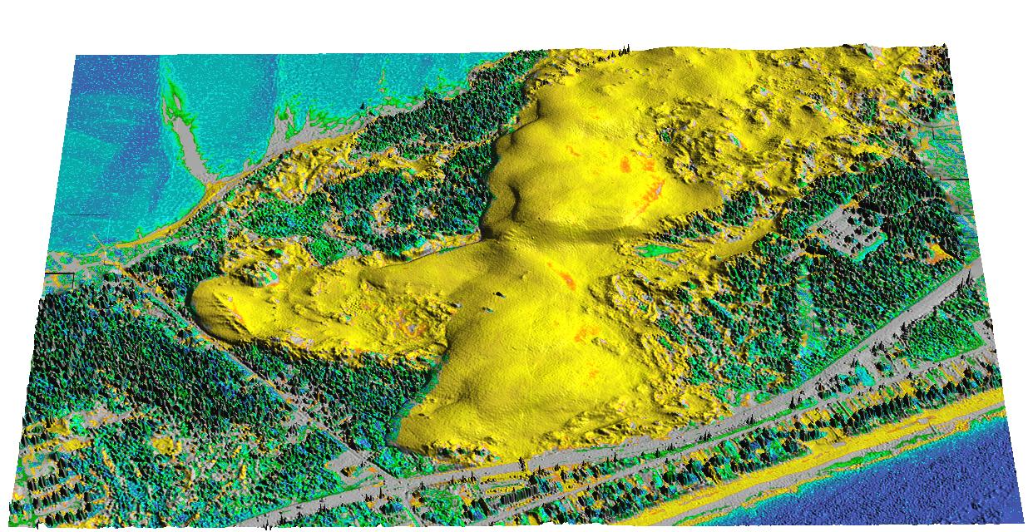
Large data

Slide 6
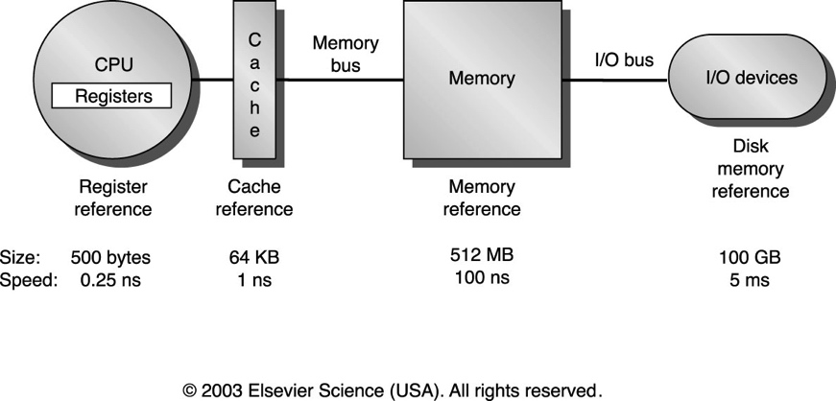
Large data

Slide 7
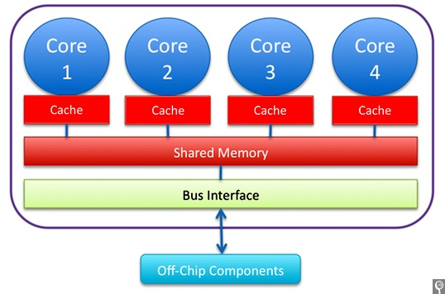
High performance computing

Slide 8
Projects
Visibility on terrains
  Understanding movement
  Visualization
  Multiple viewsheds
  Finding point of max/min visibility efficiently
  Find top 10% points with largest visibility

Slide 9
Projects
Computing viewsheds in sub-linear time
  previous: Kevin Zmozinsky, Danny Byrnes

Slide 10

Projects
Computing viewsheds in parallel
  previous: Tucker Gordon, Colin Reynolds, Andrew Murowchick
Bowdoin computing grid:
16, 32 and 40 core machines, 128GB RAM
>500 cores!

Slide 11
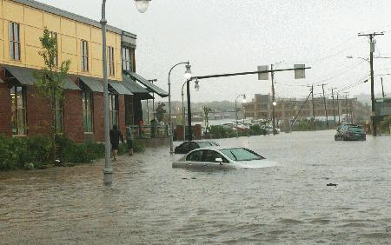
Projects: with Eileen Johnson (ES)
Simulate Coast of Maine sea level rise using LIDAR data

Slide 12
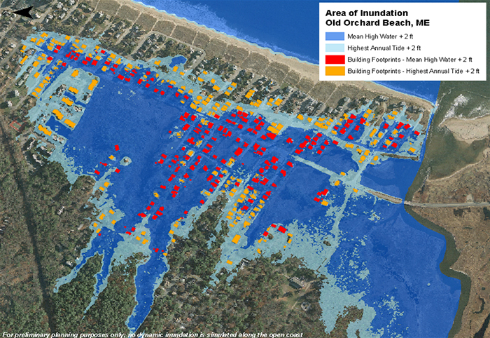
Projects: with Eileen Johnson (ES)
Simulate Coast of Maine sea level rise using LIDAR data

Slide 13
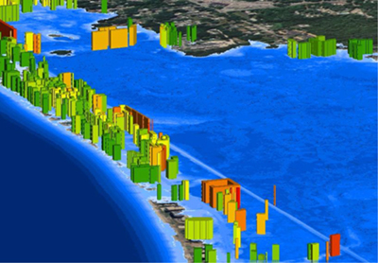
Projects: with Eileen Johnson (ES)
Simulate Coast of Maine sea level rise using LIDAR data
  Large data
  Parallel

