Slide 1
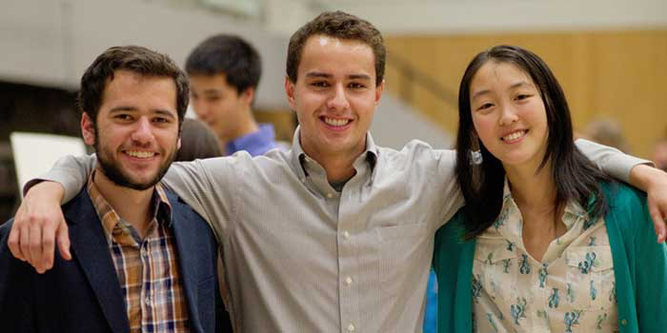
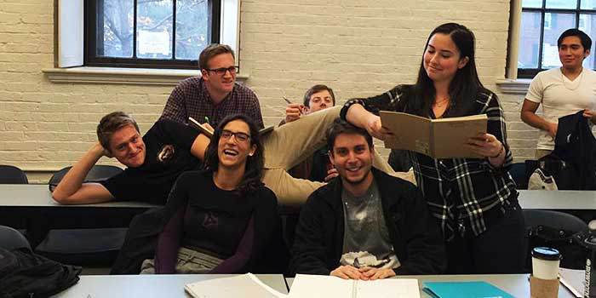
Bowdoin Computer Science

Slide 2
Reasons to study Computer Science
Computing is part of everything we do!
Expertise in computing enables you to solve complex problems
Computing enables you to make a positive difference in the world
Computing offers many types of careers
Computing jobs are here to stay
From http://computingcareers.acm.org/

Slide 3
Reasons to study Computer Science
Knowledge of computing helps you even if your primary career choice is something else
Computing offers great opportunities for creativity
Some knowledge of computing is becoming a sign of well-roundedness
Future possibilities in computing are without boundaries
From http://computingcareers.acm.org/

Slide 4
The CS intro sequence
Intro to CS
Csci 1101
Broad intro to CS and programming in Python
Pre-req: none
No CS background necessary
Fall 2015: 3 sections
Data Structures
csci 2101
Advanced programming in C/C++
Pre-req: 1101
Fall 2015: 2 sections
Algorithms
csci 2200
Design and analysis of algorithms
Pre-req: 1101 and 2101
Fall 2015: 2 sections

Slide 5
The CS Major
10 classes: 1101, 2101, 2200 + 7 electives

Slide 6
The CS minor:
5 CS classes: 1101, 2101 + 3 electives
The interdisciplinary Math-CS major:
CS: 1101, 2101, 2200 + 3 electives
Math:…

Slide 7
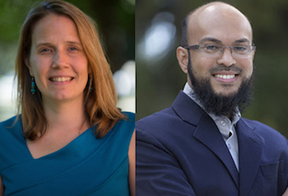
Entry-level computing-related classes
Intro to CS
CSCI 1101
Intro to DCS
INTD 1100
Introduction to problem solving using computer programming
Study of values, behavior and technologies associated with digital environments
Includes some Python programming and web apps
Required for CS major/minor
Both offered in Fall’15

Slide 8
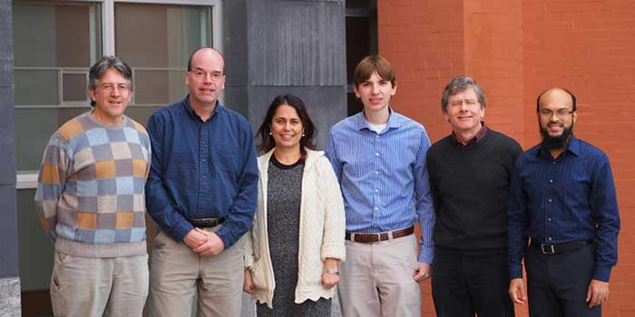
CS Faculty
Sean Barker (visiting)
Eric Chown
Clare Congdon (visiting)
Allan Harper (visiting)
Mohammad Irfan (joint with DCS)
Steve Majercik
Bill Silver (research associate)
Laura Toma

Slide 9
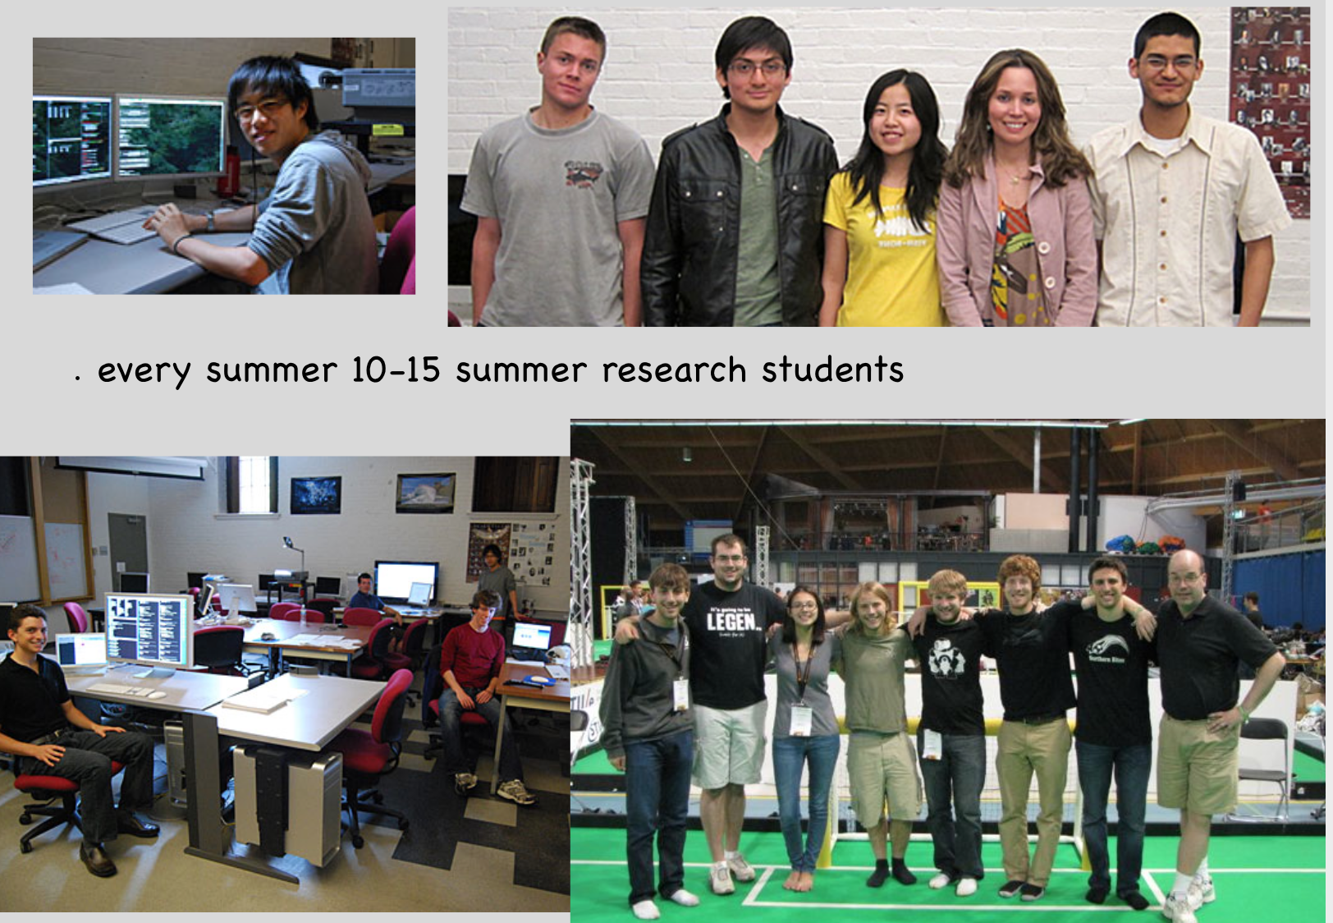
Research

Slide 10
Research
Sean Barker
Distributed systems, cloud computing, sustainability
Projects
Designing sustainable smart homes through analysis of smart meter data
Resource management in data centers (ie memory sharing in virtual machines)
On-demand live migration in cloud-based databases

Slide 11
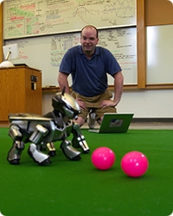
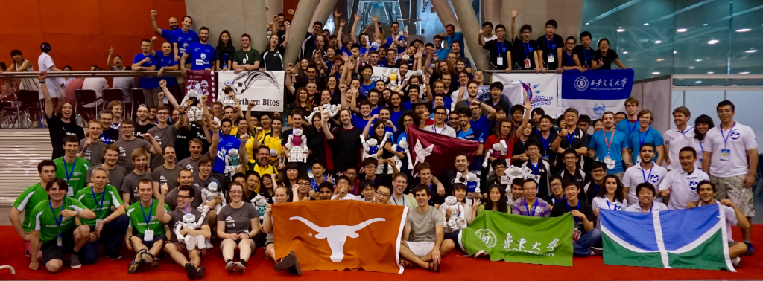
Research
Eric Chown
  Cognitive modeling, soccer-playing robots
Projects
Bowdoin’s NorthernBites team competing in RoboCup

Slide 12
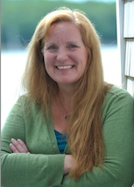
Research
Clare Congdon
Machine learning, bioinformatics
Projects
Find patterns in noncoding DNA sequence that appear to have been conserved across evolutionary time
Find the most plausible evolutionary relationships among species
Virtual Simulation of the Lobster Fishing Industry in the Gulf of Maine

Slide 13

Research
Allen Harper
Human-computer interaction, eye tracking
Projects
Predict how well a user performs a task based on eye movement. Classify users into performance groups.
NEW

Slide 14
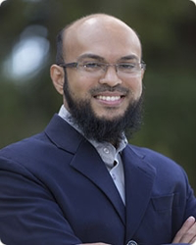
Research
Mohammad Irfan
Computational game theory, social and economic networks, CS and art
Projects
Modeling influence in economic networks
Analyzing Kandinsky’s art through geometric primitives
Authentication of Jackson Pollock’s paintings

Slide 15
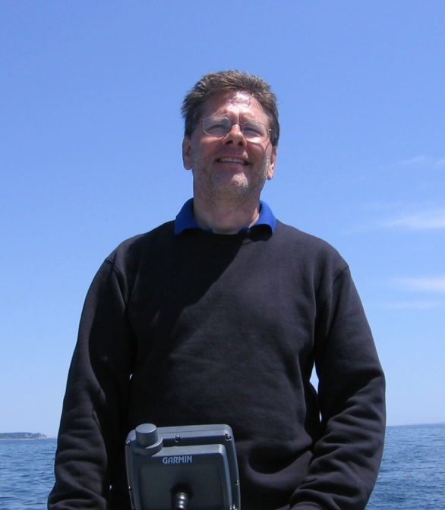
Research
Steve Majercik
Nature-inspired computational techniques, swarm intelligence and particle swarm optimization, computation and the arts.
Projects
Jazz improvisation tool using particle swarm optimization (with Frank Mauceri, Music Dept)
Swarm-based path creation in dynamic environments for search and rescue

Slide 16

Research
Laura Toma
Terrain processing in GIS; algorithm engineering; algorithms for large data; high-performance computing
Projects
Flow, flooding, watersheds, shortest path surfaces, visibility
..on very large data
..in parallel using MPI

Slide 17
Computer Science
Location: Searles, 2nd floor
Come talk to us!

Slide 18
